Slide 1




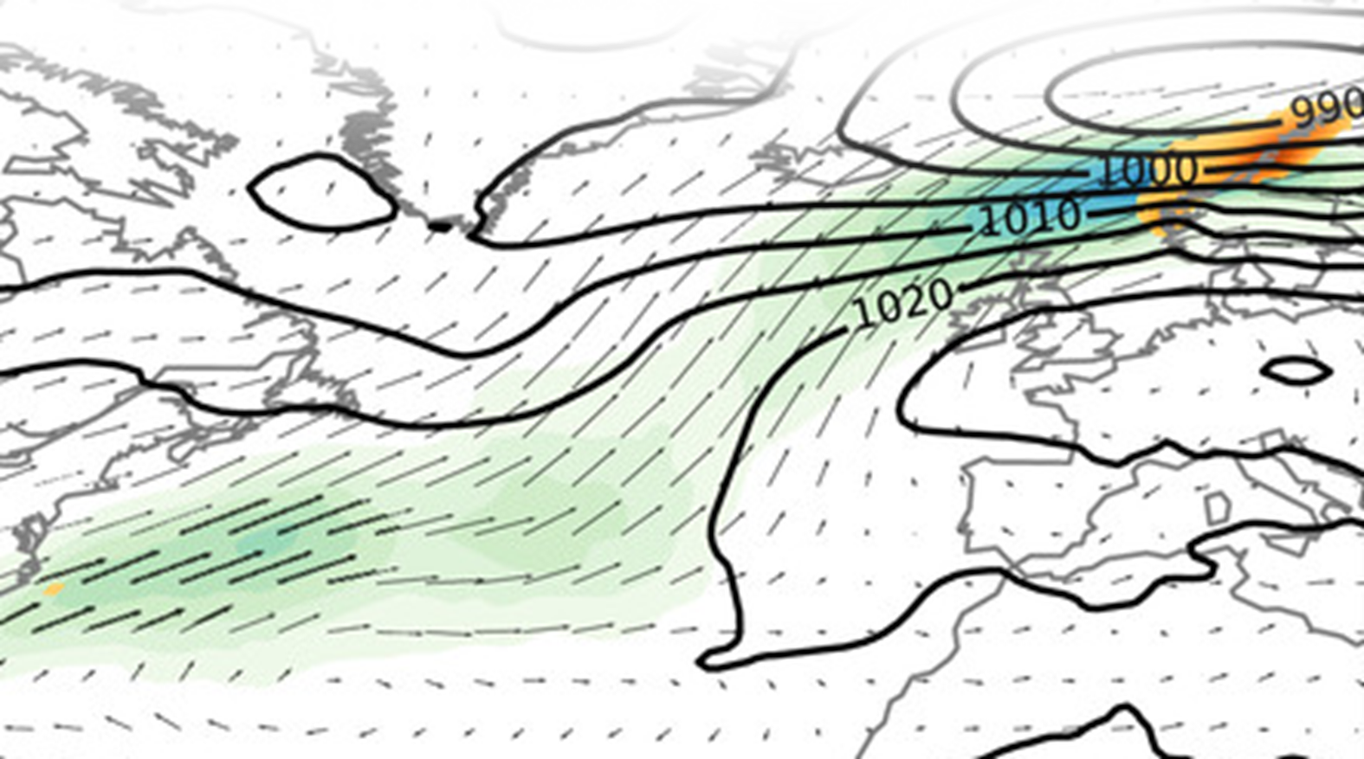








Welcome to
WAM-2Layers
!
I have a question, issue or contribution, how do I proceed?
Is it already discussed or described on the GitHub Discussions or WAM-2Layers documentation?
YES
NO
Great, feel free to join the ever-growing WAM-2Layers community under Users of WAM2Layers on GitHub.
Specific question or code issue?
Share these on the Q&A on GitHub
New ideas or contributions?
Share these on the Ideas on GitHub
Interesting results?
Discuss these under Show & Tell on GitHub
WHEN POSTING INCLUDE
Short introduction of you and the research
Description of the bug or issue
Include related documents

